Slide 1


Chapter 2
Communication

Slide 2
Message Passing
A process is a program in execution.
When we say that two computers of a distributed system are communicating with each other, we mean that two processes, one running on each computer, are in communication with each other.
resource manager process to monitor the current status of usage of its local resources, and the resource managers of all the computers might communicate with each other from time to time to dynamically balance the system load among all the computers.

Slide 3
Message Passing
Therefore, a distributed operating system needs to provide inter-process communication (lPC) mechanisms to facilitate such communication activities.
Inter-process communication basically requires information sharing among two or more processes.
The two basic methods for information sharing are as follows:
1. Shared-data approach
2. Message-passing approach

Slide 4
Message Passing
Therefore, a distributed operating system needs to provide inter-process communication (lPC) mechanisms to facilitate such communication activities.
Inter-process communication basically requires information sharing among two or more processes.
The two basic methods for information sharing are as follows:
1. Shared-data approach
2. Message-passing approach

Slide 5
Features of Good Message Passing system
Simplicity
Should be simple and easy to use.
Straightforward to construct new applications and to communicate with existing ones by using primitives.
Example: Imagine you're organizing a group outing with your friends. You need to convey the details about the venue, time, and meeting point to everyone involved.
Complex: Emails, phone calls, text messages
Simple: single messaging platform like WhatsApp or Messenger group

Slide 6
Features of Good Message Passing system
Uniform semantics
A message passing system with uniform semantics ensures that messages are interpreted consistently across different components or entities within the system.
Example: Ordering Food Online
Uniform Semantics:
When a user requests a ride, the message sent to drivers includes clear and standardized information about the pickup location, destination, and any special requests.

Slide 7
Features of Good Message Passing system
Efficiency
Inter-process communications may become so expensive if message passing system is not efficient.
An IPC protocol of a message passing system can be made efficient by reducing the number of message exchange during the communication.
Some optimizations are as follows:
Avoid cost of establishing and terminating connections between same pair of processes for each and every message exchange between them.
Minimize the cost of maintaining the connections.
Avoid several message exchanges between sender and receiver (piggybacking of acknowledgement of previous messages)

Slide 8
Features of Good Message Passing system
Reliability
Node crashes or communication link failures interrupt a communication that was progress between two processes, resulting in loss of a message.
Reliable IPC protocol can cope with failure problems and guarantees the delivery of message.
Handling loss of messages involves acknowledgement and retransmission on the basis of timeouts.
Duplicate messages may be sent in the event of failures or because of timeouts.
Duplicates can be handled by generating and assigning appropriate sequence numbers to the messages.

Slide 9
Features of Good Message Passing system
Correctness
Group communication allows sender to send the message to a group of receivers and a receiver to receive messages from several senders.
Correctness is a feature related to the IPC protocol for group communication.
Issues related to the correctness:
Atomicity: every message sent to the group of receivers will be delivered to either all of them or none of them.
Ordered: messages arrive at all receivers in an order
Survivability: guarantees that messages will be delivered correctly despite of partial failure of processes, machines, or communication link.

Slide 10
Features of Good Message Passing system
Flexibility
IPC protocol of message passing system must be flexible enough to cater the various needs of different applications.
A flexible message passing system would enable these nodes to communicate in a way that adapts to changing conditions, such as network latency, node failures, or varying message formats.
Example: consider a cloud-based e-commerce platform
let's say there's a sudden surge in traffic due to a promotional event, causing delays in the inventory management service.
In this situation, a flexible message passing system would allow the order processing service to detect the slowdown and automatically adjust its messaging strategy.

Slide 11
Features of Good Message Passing system
Security
A secure message passing system is essential for safeguarding sensitive information and preventing unauthorized access or tampering
Secure communication include:
Authentication of the receiver(s) of message by sender
Authentication of the sender of a message by receiver(s)
Encryption of message before sending it over the network.
Example: Healthcare application
Without a secure message passing system, sensitive patient information transmitted between these components could be intercepted by malicious actors

Slide 12
Features of Good Message Passing system
Portability
A portable message passing system is vital because it enables seamless communication across different platforms, devices, and environments, ensuring interoperability and flexibility.
Two different aspects of portability in message passing system:
Message passing system should itself portable i.e. it should easily construct new IPC facility on another system by reusing basic design of existing message passing system.
Primitives of the IPC protocols of the message passing system should be portable. (heterogeneity)

Slide 13
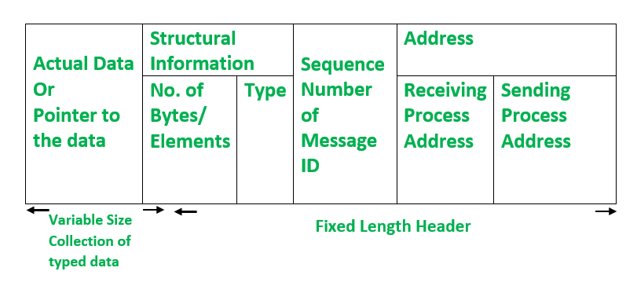
Issues in IPC by message passing
A message is a block of information formatted by a sending process in such a manner that it is meaningful to the receiving process.
A typical message structure

Slide 14
Issues in IPC by message passing
Address: it contains characters that uniquely identify the sending and receiving process in he network
Sequence number: this is message identifier (ID), used for identifying lost messages and duplicate messages in case of system failure.
Structural information: it has two parts
Type: specifies whether the data to be passed on to the receiver is included within the message or message only contain pointer to the data.
Number of bytes/elements: specifies the length of variable–size message data.

Slide 15
Issues in IPC by message passing
Address: it contains characters that uniquely identify the sending and receiving process in he network
Sequence number: this is message identifier (ID), used for identifying lost messages and duplicate messages in case of system failure.
Structural information: it has two parts
Type: specifies whether the data to be passed on to the receiver is included within the message or message only contain pointer to the data.
Number of bytes/elements: specifies the length of variable–size message data.

Slide 16
Important Issues in design of IPC protocol
Who is the sender?
Who is the receiver?
Is there one or many receivers?
Is the message guaranteed to have been accepted by the receiver(s)?
Does the sender need to wait for a reply?
What should be done if node crash or a communication link failure occurs during the course of communication?
What if receive is not ready to accept the message: will the message be discarded or stored in buffer?
In case of buffering, what should be done if buffer is full?

Slide 17
Synchronization
Synchronization is crucial in message passing systems to ensure that communication between processes or threads occurs in a coordinated and orderly manner, preventing race conditions, data corruption, and other concurrency-related issues.
Semantics used for synchronization may be classified as blocking and non- blocking types.
In case of blocking send primitive, after execution of the send statement, the sending process is blocked until it receives an acknowledgement from receiver that the message has been received.
On the other hand, for non-blocking send primitive, after execution of send statement, the sending process is allowed to proceed with its execution as soon as message has been copied to a buffer.

Slide 18
Synchronization
In case of blocking receive primitive, after execution of the receive statement, the receiving process is blocked until it receives an a message.
On the other hand, for non-blocking receive primitive, the receiving process is allowed to proceed with its execution after execution of receive statement, which returns the control almost immediately just after telling the kernel where the message buffer is.
In case of non-blocking receive primitive, how the receiving process knows that the message has arrived in the message buffer?
Polling: it’s a test primitive used by receiver to check the buffer status. Receiver periodically poll the kernel to check if the message is already available in the buffer.
Interrupt: when the message has been filled in the buffer and is ready for the use by the receiver, software interrupt is used to notify the receiving process.

Slide 19
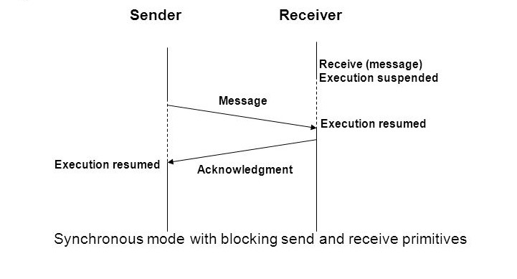
Synchronization

Slide 20
Synchronization
In blocking send primitive, the sending process could get blocked forever in situations where the potential receiving process has crashed or the sent message has been lost on the network due to communication failure. How to prevent this situation?

Slide 21
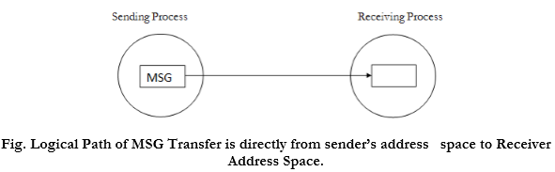
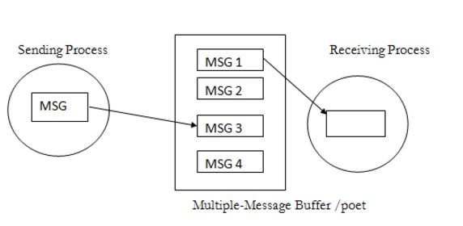
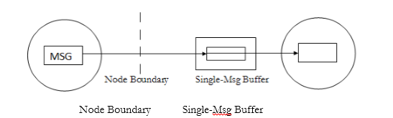
Buffering
Null Buffer
Single Message Buffer
Multiple Message Buffer

Slide 22
Buffering
Buffering is a fundamental concept in computer science and engineering, providing essential functionality in a wide range of applications, from networking and multimedia to data processing and storage.
Null Buffer: A "null buffer" or "null message buffer" is a concept used in message passing systems to represent a buffer with zero capacity or capability to hold messages.
In case of null buffering following implementation strategies may be used:
The message remains in the senders address space and the execution is delayed until the receiver executes the corresponding receive.
The message is simply discarded and the timeout mechanism is used to resend the message after a timeout period.

Slide 23
Buffering
Single message Buffer: A "null buffer" strategy is not suitable for synchronous communication because if receiver is not ready, a message has to be transferred two or more times, and receiver of the message has to wait for the entire time taken to transfer the message across the network.
In this concept, a buffer having a capacity to store a single message is used on the receiver’s node.
The main idea behind this concept is to keep the message ready for use at the location of the receiver.
The message buffer may either be located in the kernel’s address space or in the receiver’s address space.

Slide 24
Buffering
Unbounded-capacity Buffer: in asynchronous mode of communication, since a sender does not wait for the receiver to be ready, there may be several pending messages that have not yet been accepted by the receiver.
An unbounded-capacity buffer can store all un-received messages is needed to support asynchronous communication with assurance that all messages sent to the receiver will be delivered.

Slide 25
Buffering
Finite-bound Buffer: unbounded capacity buffer is practically impossible. Using asynchronous mode of communication use finite-bound buffer, also known as multiple-messages buffer.
When the buffer has finite bounds, a strategy is also needed for handling the problem of a possible buffer overflow.
Unsuccessful communication:
In this method, message transfers simply fail whenever there is no more buffer space.
The send normally returns an error message to the sending process, indicating that the message could not be delivered to the receiver because the buffer is full.
this method makes message passing less reliable.

Slide 26
Buffering
Flow-controlled communication:
The second method is to use flow control, which means that the sender is blocked until the receiver accepts some messages, thus creating a space in the buffer for new messages.
This method introduces a synchronization between the sender and the receiver and may result in unexpected deadlocks.

Slide 27
Multidatagram Messages
Multidatagram messages are a fundamental concept in networking and communication systems, providing a flexible and efficient way to transmit large amounts of data across networks while ensuring reliability, real-time responsiveness, and scalability.
All networks have an upper bound on the size of data that can be transmitted at a time, size is known as the maximum transfer unit (MTU) of a network.
A message whose size is greater than the MTU has to be fragmented into multiples of the MTU, and then each fragment has to be sent separately.
Each fragment is sent in a packet that has some control information in addition to the message data.
Each packet is known as a datagram.

Slide 28
Multidatagram Messages
Messages smaller than the MTU of the network can be sent in a single packet and are known as single-datagram messages.
On the other hand, messages larger than the MTU of the network have to be fragmented and sent in multiple packets.
Such messages are known as Multidatagram messages.
The disassembling of a Multidatagram message into multiple packets on the sender side and the reassembling of the packets on the receiver side is usually the responsibility of the message-passing system.
Example: Video Streaming
Video streaming services use Multidatagram messages to transmit video data in real-time over the internet.
Video frames are divided into smaller packets or chunks, allowing for smoother playback and adaptive bitrate streaming based on network conditions.

Slide 29
Group Communication
The most elementary form of message-based interaction is one-to-one communication (also known as point-to-point, or unicast, communication) in which a single-sender process sends a message to a single-receiver process.
For performance and ease of programming, several highly parallel distributed applications require that a message-passing system should also provide group communication facility.
Types of communications:
One to many (single sender and multiple receivers)
Many to one (multiple senders and single receiver)
Many to many (multiple senders and multiple receivers)

Slide 30
One to many Communication
There are multiple receivers for a message sent by a single sender.
One-to-many scheme is also known as multicast communication.
A special case of multicast communication is broadcast communication, in which the message is sent to all processors connected to a network.
Multicast:
consider a server manager managing a group of server processes all providing the same type of service.
The server manager can multicast a message to all the server processes, requesting that a free server volunteer to serve the current request.
It then selects the first server that responds.

Slide 31
One to many Communication
Broadcast:
to locate a processor providing a specific service, an inquiry message may be broadcast.
In this case, it is not necessary to receive an answer from every processor; just finding one instance of the desired service is sufficient.

Slide 32
One to many Communication
Group Management
A closed group is one in which only the members of the group can send a message to the group.
An outside process cannot send a message to the group as a whole, although it may send a message to an individual member of the group.
On the other hand, an open group is one in which any process in the system can send a message to the group as a whole.

Slide 33
One to many Communication
Example: A closed group is a group of processes working on a common problem need not communicate with outside processes and can form a closed group.
Example: On the other hand, a group of replicated servers meant for distributed processing of client requests must form an open group so that client processes can send their requests to them.
The message-passing system must have a mechanism to manage the groups and their membership information.
A simple mechanism for this is to use a centralized group server process.
All requests to create a group, to delete a group, to add a member to a group, or to remove a member from a group are sent to this process.
Limitation: suffers from poor reliability and poor scalability
Replication of server can be done which leads to extra overhead of maintaining consistency of group servers.

Slide 34
One to many Communication
Group Addressing
A two-level naming scheme is normally used for group addressing.
The high-level group name is an ASCII string that is independent of the location information of the processes in the group.
On the other hand, the low-level group name depends to a large extent on the underlying hardware.
For example, on some networks it is possible to create a special network address to which multiple machines can listen.
Such a network address is called a multicast address.
A packet sent to a multicast address is automatically delivered to all machines listening to the address.
Therefore, in such systems a multicast address is used as a low-level name for a group.

Slide 35
One to many Communication
Group Addressing
Networks with broadcasting facility declare a certain address, such as zero, as a broadcast address.
A packet sent to a broadcast address is automatically delivered to all machines on the network.
Therefore, the broadcast address of a network may be used as a low-level name for a group.
System that uses a broadcast address for group addressing, all groups have the same low-level name, the broadcast address.

Slide 36
One to many Communication
Message Delivery to Receiver Processes
The centralized group server maintains a mapping of high-level group names to their low-level names.
The group server also maintains a list of the process identifiers of all the processes for each group.
When a sender sends a message to a group specifying its high level name, the kernel of the sending machine contacts the group server to obtain the low-level name of the group and the list of process identifiers of the processes belonging to the group.
The list of process identifiers is inserted in the message packet.

Slide 37
One to many Communication
Message Delivery to Receiver Processes
If the low-level group name is either a multicast address or a broadcast address, the kernel simply sends the packet to the multicast/broadcast address.
On the other hand, if the low-level group name is a list of machine identifiers, the kernel sends a copy of the packet separately to each machine in the list.
When the packet reaches a machine, the kernel of that machine extracts the list of process identifiers from the packet and forwards the message in the packet to those processes in the list that belong to its own machine.

Slide 38
Many to one Communication
Multiple senders send messages to a single receiver.
The single receiver may be selective or nonselective.
A selective receiver specifies a unique sender; a message exchange takes place only if that sender sends a message.
On the other hand, a nonselective receiver specifies a set of senders, and if anyone sender in the set sends a message to this receiver, a message exchange takes place.

Slide 39
Many to Many Communication
Multiple senders send messages to multiple receivers.
an important issue related to many-to-many communication scheme is that of ordered message delivery.
Ordered message delivery ensures that all messages are delivered to all receivers in an order acceptable to the application.
For example:
Suppose two senders send messages to update the same record of a database to two server processes having a replica of the database.
If the messages of the two senders are received by the two servers in different orders, then the final values of the updated record of the database may be different in its two replicas.

